Slide 1
TIO changes: 2018-21 NLTP
Improvements– detail for takeaway

Slide 2
Improvements
Key changes in TIO
Assessment of the business case
Redundant fields removed & greater transparency
Support for benefit reporting
Aligning with business case approach – ensuring BCA principles utilised in development of programme
Questions reviewed to ensure all questions that remain are important to our decision making
Clarity of primary benefits and corresponding outcome class, with improved benefit reporting.
Notes:
Also – greater level of in-built help text; update to assessment section to reflect new IAF

Slide 3
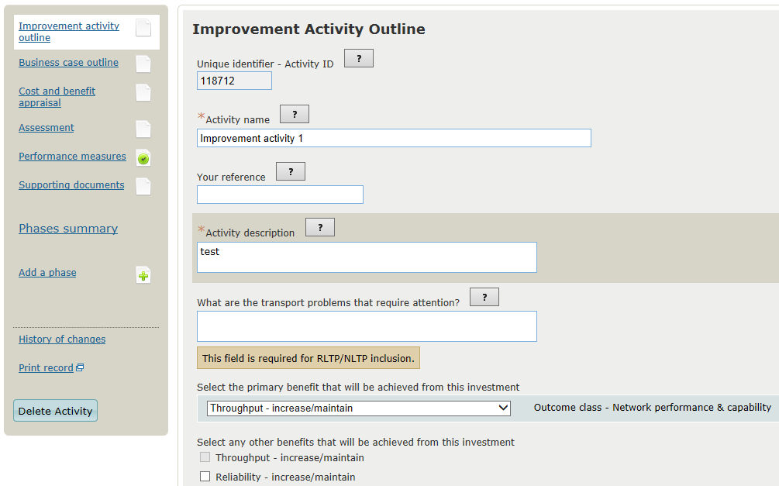
Improvements
TIO changes – in depth
Greater use of inbuilt help text by clicking on [?]
Outcome class displayed
Notes:
New fields circled – Activity identified clearly displayed; primary benefit aligned to ILM benefits and outcomes

Slide 4
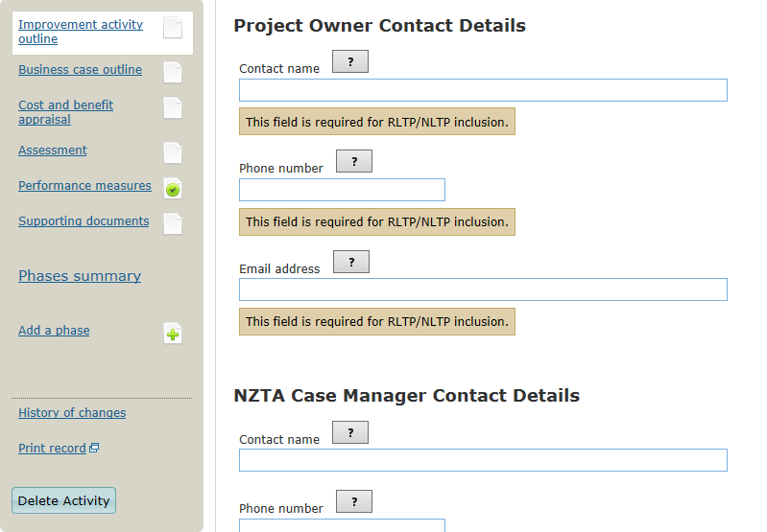
Improvements
TIO changes – in depth
Contact details moved to outline page
Notes:
Contact details, both project owner and NZTA case manager moved to outline page

Slide 5
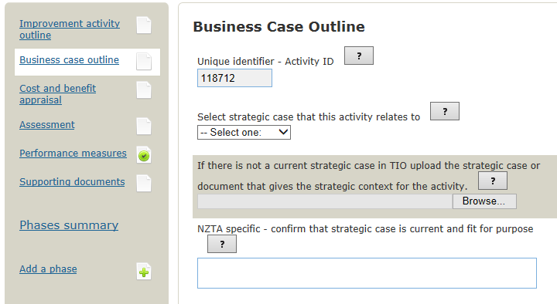
Improvements
TIO changes – in depth
Notes:
New “Business Case Outline” page – requires link to strategic case and programme business case (if appropriate)

Slide 6
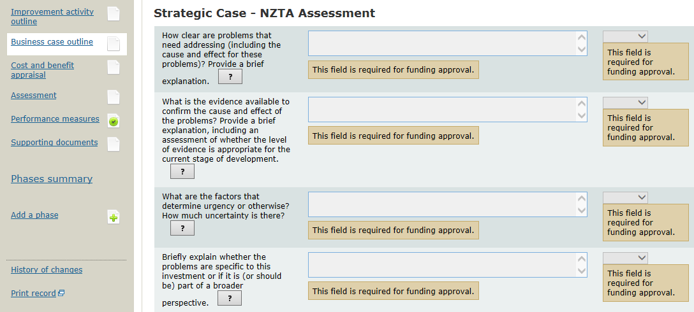
Improvements
TIO changes – in depth
Further in-built help text
Pass/Rework/Fail ratings selected
Notes:
Assessment of the business case by NZTA input directly into TIO. Room for commentary and a drop down box for “Pass/Rework/Fail” rating.
8 questions related to the strategic case will flow through from the strategic case in TIO once linked, further 4 questions related to the programme business case (note, if no PBC developed these questions will need to be answered in the improvements module), and the final 4 at funding request for implementation funding.
Pass/Rework/Fail rating against every question + a overall business case rating. *You don’t necessarily need a “Pass” on all questions to get an overall “Pass” further guidance on this will be made available soon.

Slide 7
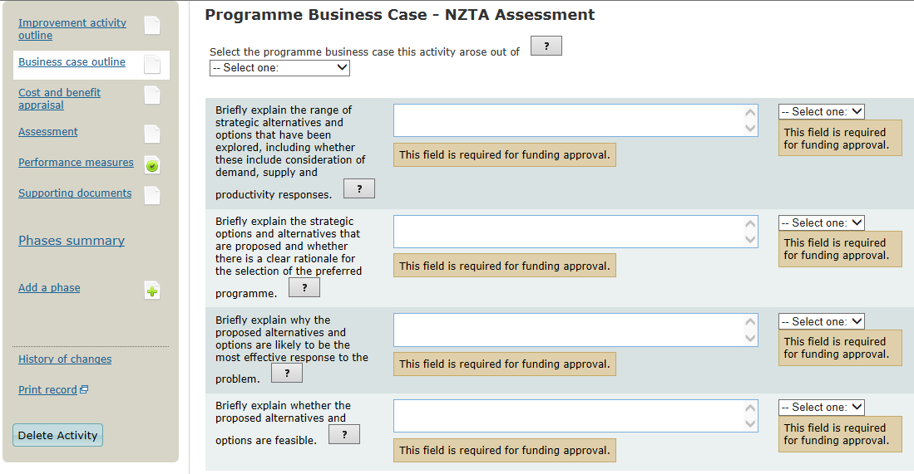
Improvements
TIO changes – in depth
Further in-built help text
Pass/Rework/Fail ratings selected
Notes:
Assessment of the business case by NZTA input directly into TIO. Room for commentary and a drop down box for “Pass/Rework/Fail” rating.
8 questions related to the strategic case will flow through from the strategic case in TIO once linked, further 4 questions related to the programme business case (note, if no PBC developed these questions will need to be answered in the improvements module), and the final 4 at funding request for implementation funding.
Pass/Rework/Fail rating against every question + a overall business case rating. *You don’t necessarily need a “Pass” on all questions to get an overall “Pass” further guidance on this will be made available soon.

Slide 8
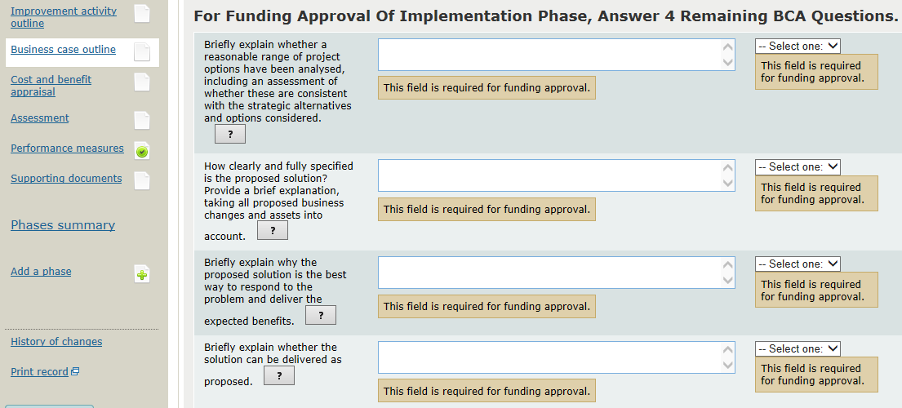
Improvements
TIO changes – in depth
Further in-built help text
Pass/Rework/Fail ratings selected
Notes:
Assessment of the business case by NZTA input directly into TIO. Room for commentary and a drop down box for “Pass/Rework/Fail” rating.
8 questions related to the strategic case will flow through from the strategic case in TIO once linked, further 4 questions related to the programme business case (note, if no PBC developed these questions will need to be answered in the improvements module), and the final 4 at funding request for implementation funding.
Pass/Rework/Fail rating against every question + a overall business case rating. *You don’t necessarily need a “Pass” on all questions to get an overall “Pass” further guidance on this will be made available soon.

Slide 9
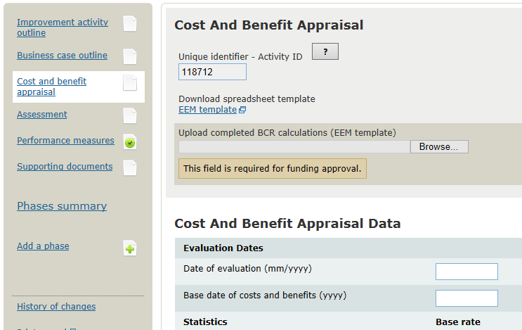
Improvements
TIO changes – in depth
Notes:
Minimal change to cost and benefit appraisal page.

Slide 10
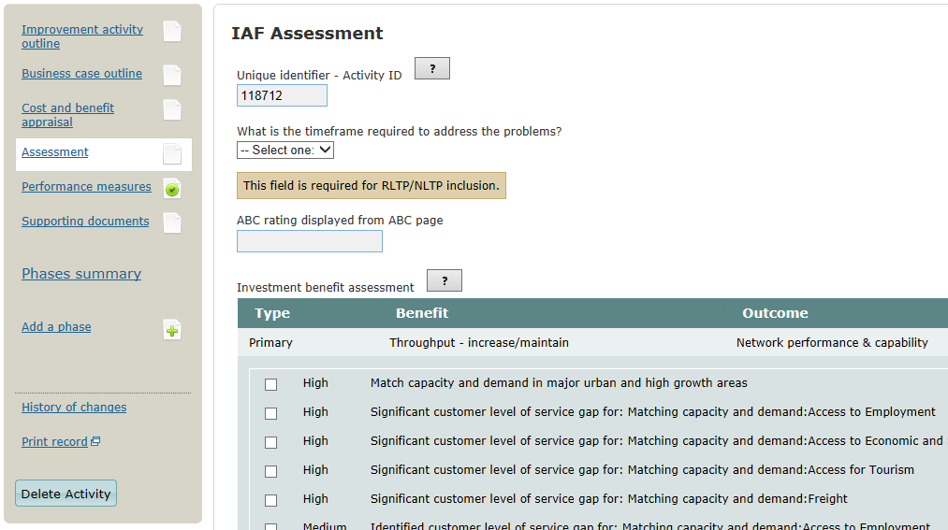
Improvements
TIO changes – in depth
Notes:
Assessment page now has a timeframe dropdown box to give decision makers a sense of the urgency of the problems to be addressed.
Suggested results alignment rating provided, based on the benefit selected on the outline page. This is a suggestion only, the project owner and NZTA IAF assessment sections both have drop down and commentary boxes for results alignment, as it is currently for strategic fit.
Effectiveness gone. Cost and benefit appraisal rating and commentary box – no change.

Slide 11
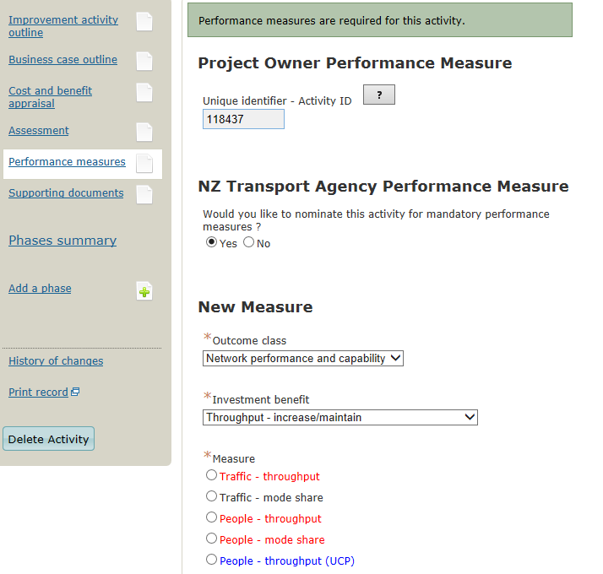
Improvements
TIO changes – in depth
New module for performance measures
Notes:
Performance measures tab added
Minimal changes to remaining tabs – supporting documents and phase pages.

Slide 12
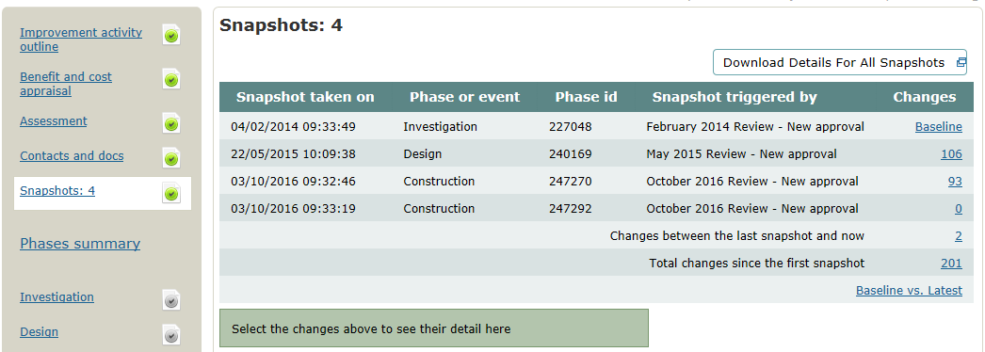
Improvements
TIO changes – in depth
Notes:
Addition of “snapshots” – system generated snapshots of project details at set trigger points – funding approval, material cost scope adjustments etc.
Minimal changes to remaining tabs – supporting documents and phase pages.

