Slide 1

The Investment Assessment Framework
Notes:
Should be finalised by end 2017, once GPS 2018 has been published

Slide 2
What’s changed
Effectiveness not used
Rating includes Very High
Urgency
Low Cost / Low Risk
“99” BCR
not used
remove perceived overlap
greater emphasis on business case assessment
assessment before IAF
VH rating on one factor sets the priority regardless of other factor
timeframe required to address the problem
replaces Minor Improvements
< $1m
e.g.
Bridge Replacement will be “PV_EoL”
Stock effluent facilities will have a generic BCR
Notes:
Business Cases should address the criteria which was included in Effectiveness, namely:
is outcomes focused
is integrated
is correctly scoped
is affordable
is timely
provides confidence
VH Rating: Results Alignment refers to specific government priorities. Value for VH Cost-Benefit Ration to be confirmed.
Urgency factor required for the Strategic Case Assessment. Provides context for assessment of following BCs.
Low cost/low risk activities allow for stream-lined assessment process, while providing reasonable assurance of VfM.
Not using 99 as it distorts average BCRs. Generic BCR for stock effluent faculties to be confirmed.

Slide 3
Proposed future state Investment Assessment Framework
Change for 2018-21:
  move from a three to two factor assessment
  no effectiveness rating
  many of the elements of the current effectiveness structure are being considered in the Business Case Approach
Results Alignment (Previously Strategic Fit)
As before with aspects of the effectiveness assessment related to network context
Benefit cost ratios and cost effectiveness
Cost-Benefit Appraisal
Notes:
Not finalised until GPS 2018 published

Slide 4
Business case alignment to Investment Assessment Framework relationship
DRAFT
The business case principles and investment assessment are clearly linked. The Business Case Approach will be integrated with the decision making process through the Assessment of Business Case.
Business Case Approach
Point of Entry /
Strategic Case
Programme Business Case
Indicative / Detailed Business Case
Assessment of Business Case
Pass/Rework/Fail
Pass/Rework/Fail
Pass/Rework/Fail
Investment Assessment Framework
Results Alignment
Cost-Benefit Appraisal
Notes:
Relates to the stages of improvement application.
Note that the Strategic Case module was developed as a result of feedback on current process.

Slide 5
Key assessment requirements
Assessment:
Supported by:
Results Alignment
What is the significance of the case for change (Strategic Case) to the desired results in the Government Policy Statement (is it in the public interest)?
Cost-Benefit Appraisal
How efficient is the proposal?
Assessment of Business Case
(pass / rework / fail )
Is there evidence that the proposed response best solves the problem identified (is it effective)?
Programme Support
(3 / 10 / 10+ years)
What is the urgency to address the problem?

Slide 6
2018-21 NLTP Priority
Results Alignment
VH
1
1
1
1
H
5
4
3
2
M
6
5
4
2
L
2
L
M
H
VH
Cost-Benefit Appraisal
Notes:
Very High sets the priority – NB not finalised

Slide 7
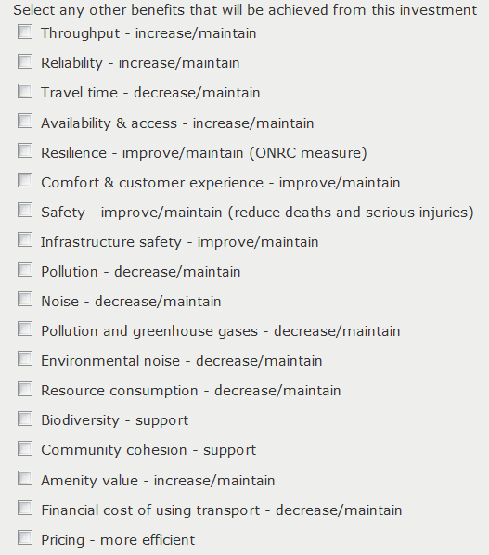
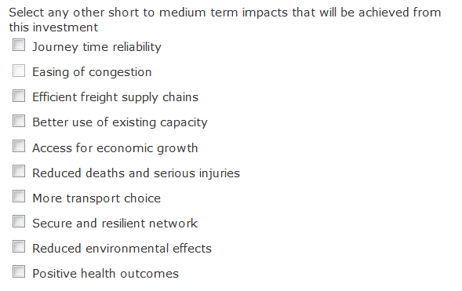
Mapping impacts to benefits
Notes:
To be confirmed
Access for Economic Growth Availability & access - increase/maintain
Better Use Capacity Throughput - increase/maintain
Easing of Congestion Comfort & customer experience - improve/maintain
Efficient Supply Chains Travel time - increase/maintain
Journey Time Reliability Reliability - increase/maintain
Reduced Deaths and Serious Injuries Safety - improve/maintain (reduce deaths and serious injuries)
More Transport Choice Availability & access - increase/maintain
Positive Health outcomes Pollution - decrease/maintain or Noise - decrease/maintain
Reduced Environmental effects Pollution and greenhouse gases - decrease/maintain
Secure and Resilient network Reliability - increase/maintain

Slide 8
Miscellaneous
Packages
  they’re back !!
  a collection of activities that deliver synergistic benefits
  development should be BCA-led
  to be set up within the Improvements template
  projects have the same assessment profile as their linked “lead activity”
BCRs
  only default value is for Stock Effluent Facilities, all other instances where BCR of “99” was previously used should now use “PV_EoL”
Notes:
Packages functionality to be developed. We are assuming that there will be a “Lead activity” which holds the BCR information and the other activities will have greyed out, blank fields with a link to the lead activity. By doing this we will remove “double-counting” of benefits.
Stock effluent facility value TBC

Slide 9
What does good look like?
The NZ Transport Agency is working collaboratively with investment partners to deliver quality content that:
  Is evidence based
  Clearly articulates assumptions
  Shows consistent assessment
  Demonstrates programme delivery is well managed
  Allows reporting on objectives and outcomes
Assessment of the business case – covered in the following sessions

Slide 10
Improvement activities which straddle two NLTPs
Phases with funding approval:
    will continue into the 2018-21 NLTP
    will continue to be assessed using the 2015-18 NLTP Investment Assessment Framework
Phases included in 2015-18 NLTP and submitted for the 2018-21 NLTP:
    have to be included in the 2018-21 NLTP
    will use the 2018-21 NLTP Investment Assessment Framework
    will require a strategic case
Notes:
Inclusion in 2018-21 NLTP is not automatic. Must meet requirements of new IAF.
What to do if future phases no longer meet threshold ?? Unlikely, but…
Ensure “Effectiveness” visible until end of current NLTP and will be in the 2018-21 NLTP extract.
Activities which have an attached strategic case will have to create a strategic case in TIO and transfer the information to that – TBC but we may relax this for current activities.

