Slide 1
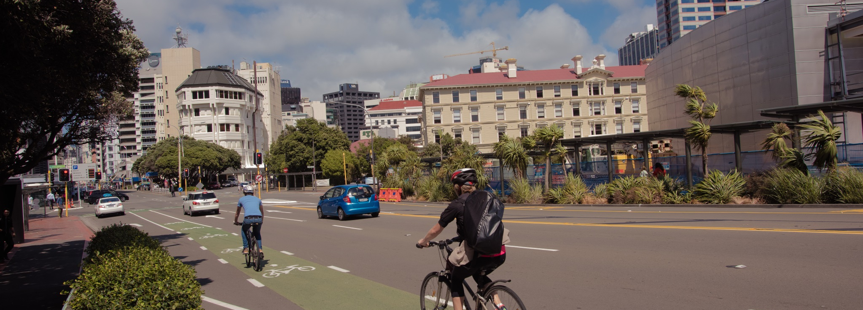
The RLTP/NLTP
Preparing your transport programmes for the next NLTP
Notes:
Note that:
LTMA hasn’t changed, so same process as last time
Should be part way through a 6-year RLTP, so we would expect Transport Programmes to be building on this
The “Transport Programme Development” user manual in TIO provides a good description of the process and what you do in TIO.

Slide 2
NLTP Objective
Achieve best outcomes for NZ transport system:
by optimising allocation of anticipated revenue to ensure value for money when investing in the transport system;
through a collaborative process the Transport Agency will provide certainty for Investment Partner;
within GPS activity class funding ranges set by the Minister;
by following a cash-flow plan that recognises risk and NZTA’s debt limits.
Published NLTP is a snap shot of a dynamic & continuous process.
Notes:
The Transport Agency work within boundaries, so have to focus spend on best VfM
The Transport Agency needs good, evidence-based information to assess activities against these objectives. But we will also provide feedback and work with Investment Partners to help develop their Transport Programmes.
The 2018-21 NLTP will be published July 2018, but it is recognised that it will evolve. Priorities change, new opportunities are identified.
BUT same process applies regardless of whether activity is submitted for inclusion before or during the 2018-21 NLTP.

Slide 3
Timeframe for creating transport programme
How to get from here to a Draft RLTP
Now – end July
Continuous Programme Templates launched
Improvement Templates launched
TIO migration
Draft RLTPs
Development of new TIO templates
Improvement activities can continue to use old templates
End July 2017
End July 2017
Only need to add missing information & submit to RTC
Deadline for submission in TIO published by your RTC
Notes:
Can’t input Continuous Programmes until the templates are ready (but can still work on them).
We will prioritise continuous programmes templates to make them available ASAP, but end of year processing will impact the exact date.
Migration will allow Investment Partners to create Programme Business Cases and Improvement activities now.
RTCs have to work back from the NLTP deadlines to set the RLTP dates (allowing for processing before presenting to the RTC for review and sign-off).

Slide 4
NLTP development process
From RLTP to NLTP
Review RLTPs
Reviewed RLTPs
Moderate NLTP
Indicative Programmes
Board adopts NLTP
From late 2017
Review updated RLTPs & consult if required
Must be revised by end April 2018
Quarter1 2018
Overlap with RLTP update
Consider levels of funding in activity classes
Mid-April 2018
Maximise allocation within GPS range(s)
Special meeting June 2018
Notes:
Draft RLTP deadline = organisations will be locked out of their Transport Programmes. Contact RTC to unlock.
Currently part way through the 6 year RLTP, consultation on RLTPs will only be if there are significant changes.
Transport Agency will take and file extracts from TIO at key points to record development of the Transport Programmes.

Slide 5
Key stages to getting funding
The information required at each stage
RLTP first – a requirement of the LTMA
Continuous programmes – need to clear both gateways when NLTP is approved
(Maintenance, PT services, Road safety promotion)
Improvement activities – only need to clear the first gateway (results alignment crucial)
Funding approvals process remains the same as do delegations – no short cuts
Notes:
Chart represents amount of information required at key stages.
Continuous programmes will require the full amount of information.
Please don’t place holder activities which don’t have their NZTA Assessment fields completed, e.g. resilience improvements. Only activities which can be properly assessed will be included in the NLTP.
The automated snapshots are being developed for the Improvements template and will be available in TIO:
At the first New Approval
Every Cost-Scope adjustment > $1,000 (Total Cost – TBC ?)

Slide 6
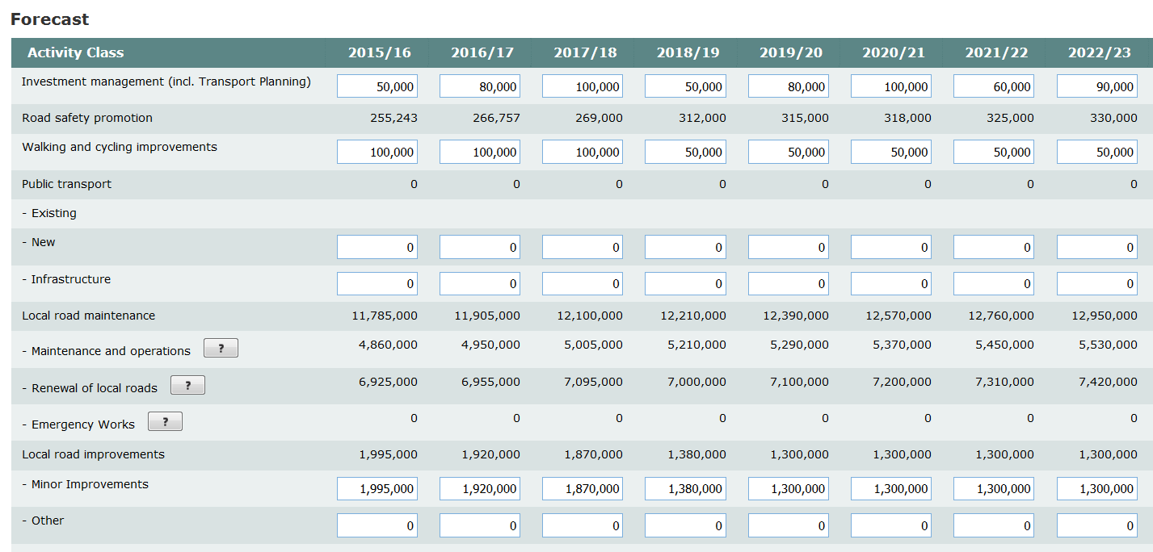
10 Year forecast by activity class 2018-21
Halfway through 6 year RLTP, so update current forecast
Existing forecasts from
2015-18 NLTP to be updated
Updated forecasts from new programme activities
Actual expenditure/forecast for 2015-18 NLTP
Notes:
Forecasts recognises that we are part way through a 6 year RLTP and will not extend beyond the current 10 year period.
Hence will bring forward information from 2015-18 NLTP forecast to be reviewed and updated.
First 3 years will reflect current expenditure and approvals (NB moving target, will update when ever the approved funds or programme forecasts update).
Emergency works will pick up committed funding across the 10 years, no need to provide anything else.
Continuous programmes (Maintenance, PT Services and Road Safety Promotion) will pick up the forecasts from these activities.
Improvement activity forecasts will need to be reviewed and updated.
NB Forecasts should reflect what is expected to be delivered, not the sum of the individual activities.

Slide 7


Getting activities into the NLTP
Applications must be:
  Eligible, and
  Complete (green ticks)
Extra help information has been added to TIO, see
Refer to P&I Knowledge Base
Checked by RTCs as part of RLTP test, with Transport Agency assistance
BCR not required for improvements at this point – defaults to 1* rating
Activities will be included as “Probable” or “Proposed”
Notes:
Probable: Funding has not yet been approved for the activity but, based on its profile and the robust evidence provided in developing the NLTP, funding approval is likely for an application made during the NLTP.
Proposed: Based on its profile and the evidence provided in developing the NLTP, funding approval may be given when an application is during the NLTP. However, further evidence is required to confirm the assessment profile and provide confidence in the funding priority.
For either funding priority, funding approval is subject to funds being available.

Slide 8
Funding approval
Applications must:
  Be complete – all required TIO fields, including cost benefit appraisal
  Have required supporting information to appropriate standard
  Follow through the Transport Agency’s approvals process with approvals made under the delegations policy
Since continuous programmes get funding approval at the start of the NLTP:
  there is a more detailed focus on assessment
  indicative allocations will optimise use of GPS funding, but may not fund requested allocation
FARs
  recalculated for the 2018-21 NLTP using latest data
  Approved Organisations with changes will already have been informed
Notes:
Delegations
Board approve Continuous Programmes
mapping to new Transport Agency structure TBD
GPS ranges limit how much we can allocate/approve, especially for Continuous Programmes.
Any changes to transition or final Normal FARs will have already been communicated to the relevant Approved Organisations

Slide 9
All investment decisions
Must be the result of applying the NZTA’s Assessment Framework
Must be based on the evidence provided in TIO or as supporting (electronic) hard copy
Must reflect the national view and will be based on objective assessments

Slide 10
Current Initiatives
What MUST be completed this NLTP
Enhanced FARs for accelerated LED activities
    85% average FAR only available for the 2015-18 NLTP
    funds carried over will get Approved Organisation’s Normal FAR
R-funds
    assigned to activities and get funding approval before 30 June 2018
    future activities will use the “Regional Improvements” activity class
  Urban Cycleway Fund
    Crown funds MUST be claimed by end of the 2015-18 NLTP
    Claim Crown funds BEFORE NLTF funds
Notes:
LED: Note that the enhanced FAR is 85% across the 3-year programme, so can get higher FAR if work carried out during 2015/16 and claimed at Normal FAR. Also note the paragraph on completion by December 2018 in the general circular referring to pre-purchased luminaires. Any luminaires purchased using the enhanced FAR (i.e. by 30 June 2018) must be installed by 31 December 2018.
UCF: Minister has agreed Crown funds can be claimed before NLTF claims. Please adjust cost profile to reflect this as it will help us approve requests for funding non-UCP walking & Cycling activities.

Slide 11
Use of TIO extract
How to review your transport programme
TIO extract under MORE tab
Process:
  Select activities & status (when in doubt select all)
  Extract info from TIO to spreadsheet (available)
  Use PIVOT tables to select & summarise data

Slide 12

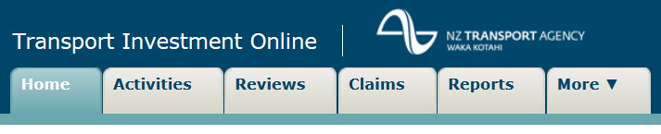
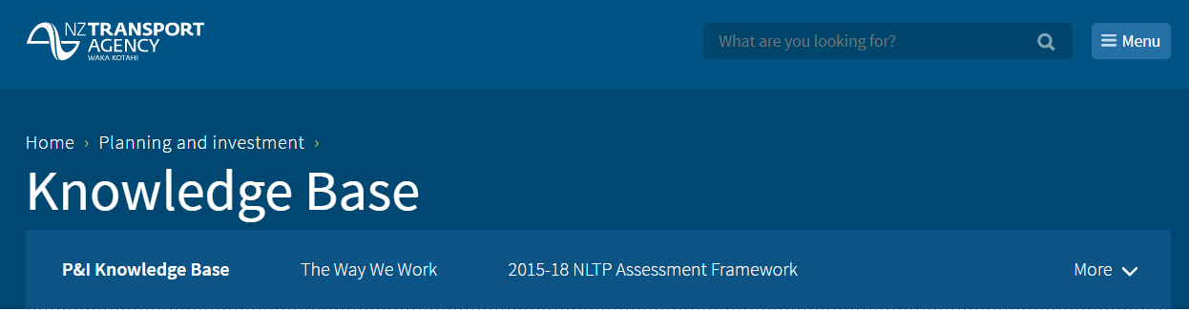
Summary and Help
TIO Problems – use “Contact Us” in TIO
Planning & Investment Knowledge Base – email
heather.benwood@nzta.govt.nz
douglas.robertson@nzta.govt.nz
Notes:
IAF help – IAF page on the NZTA website
BCA online training

