Slide 1
Continuous programmes
IAF application JUNE 2017

Slide 2
Continuous programmes (draft IAF application)
Points for discussion:
Definition of continuous programmes
The draft IAF in relation to programmes
Timelines : continuous programmes approval process

Slide 3
Overview of continuous programmes
A continuous programme is a group of activities, relating to existing assets and services, delivered on an on-going basis from one NLTP to the next to maintain an adequate level of service.
NLTP funding for continuous programmes is considered as a single bid for each three year NLTP period.
The level of funding support necessary is determined via discussion and negotiation between the Transport Agency and investment partner involved.

Slide 4
Types of continuous programmes
A continuous programme and its group of activities relate to one of the following:
Road maintenance (maintenance, operations and renewal of existing assets and levels of service)
Public transport (existing services and operational amenities)
Road safety promotion

Slide 5
Maintenance programmes
Core programme
Eligible works within an investment partner’s roading programme of maintenance work required to achieve or maintain a pre-determined level of service
Based on AMP and supporting information
Should be negotiated and refined through until final submission
Enhanced programme:
Addresses significant CLoS gaps through enhanced maintenance scope / practice.
Should demonstrate a need for change in investment to address a significant gap in CLoS for the GPS priorities under the IAF criteria for a High Results alignment rating.
Note: Major gaps in CLoS requiring capital investment are addressed through the improvements activity classes.
Notes:
We are looking for a well evidenced programme that is incorporating the ONRC framework and demonstrating how the AO will ensure delivery of value for money
We require more than a simple programme based on existing expenditure plus provision for cost escalation.
If an AO can demonstrate through its business case (primarily the AMP) a need for Step change in investment to manage level of service gaps we will consider that in two parts.
One is right sizing the CORE programme and the other is where a short term investment is need to address a high priority area signalled in the GPS

Slide 6
Key Principles
Major gaps in service level requiring capital investment are addressed through the improvements activity classes, e.g.:
Adding capacity to achieve travel time reliability
When a road / road feature requires significant change in configuration to move from the standard for one category of classification to a higher standard for another.
A Maintenance programme can address service level gaps through enhanced maintenance practise, e.g.:
Improving TTR through better traffic management, customer info, etc (the TOCs)
Improving resilience through proactive maintenance
Justified additional programme scope /scale
Notes:
We are looking for a well evidenced programme that is incorporating the ONRC framework and demonstrating how the AO will ensure delivery of value for money
We require more than a simple programme based on existing expenditure plus provision for cost escalation.
If an investment partner can demonstrate through its business case (primarily the AMP) a need for step change in investment to manage level of service gaps we will consider that in two parts.
One is right sizing the CORE programme and the other is where a short term investment is needed to address a high priority area signalled in the GPS

Slide 7
Mock-up of TIO Work Categories screen

Slide 8
Continuous programmes for public transport
Refers to existing services.
Can include a reconfigured network, resulting in an expected increase in CLoS within the existing funding envelope.
Service improvements that result in an increased CLoS at an increased annualised cost* must be funded separately, as improvements**.
Discussion with the Transport Agency may be required as to how best to carry this out.
Notes:
* Beyond cost escalation and a reasonable allowance for this
** Improvement module depends on the size –if it is low cost (<$1M then it is covered via the LR-LC module), otherwise the standard improvements application including approach to the business case requirements
Once service improvement is complete, service becomes art of the PT continuous programme

Slide 9
Continuous programmes for road safety promotion
Relate to promotion, education and advertising activities that promote the safe use of the land transport network.
Treated as continuous programmes to give our partners surety of ongoing funding.
Majority of programmes <$1M, so streamlined approach to assessment utilised.
Notes:
Road safety promotion programmes are not programmes of work designed to maintain a level of service, as with the other continuous programmes
Ongoing funding required to ensure efforts remain to improve and maintain safe road use.
The Transport Agency would expect that the majority of road safety promotion programmes will utilise a streamlined assessment approach, where activities cost less than $1M.
Programmes with activities <$1M will utilise a streamlined assessment approach, whereby a formal business case is not required, it is expected that BCA principles will have been followed in the planning and development of the programme. Through RSAP and AMP development.
For larger programmes, it is expected that the programme will be covered in a formal business case. Either standalone or as part of a wider business case.

Slide 10
The draft IAF in relation to programmes
Refresher:
Results alignment supersedes strategic fit
Cost and benefit appraisal still required for programmes
Effectiveness component no longer part of the assessment
In addition:
Increased emphasis and transparency of the business case approach and the adoption of the principles related to this.
Elements of the current effectiveness are considered in the Business Case Approach and also via Results alignment
Notes:
Effectiveness component is part of the Business Case Approach (not gone, just moved).

Slide 11
Results alignment for continuous programmes
The proposed, general approach for programmes is the following:
Default results alignment rating for programmes will be low
A medium rating is provided where the programme demonstrates it will (or already does) deliver some or all of the priority result areas in the GPS or addresses an identified gap in meeting appropriate customer levels of service.
A high results alignment identifies a significant gap in meeting appropriate customer levels of service, or contributes and supports economic growth and productivity.*
Notes:
*Note, if there’s a higher level of service then ultimately there is likely to be improvements from a separate activity (either LCLR or Improvement)

Slide 12
Cost and benefit appraisal for continuous programmes
Cost and benefit analysis for a continuous programme is not new
Primarily done via reviewing:
The cost effectiveness of the programme’s activities -one NLTP to the next;
Trends of programmes over time and benchmarked to other similar investment partners, via reviewing supporting analytics and spreadsheets (e.g. the cost and benefit appraisal template for public transport)
Note: For both maintenance and public transport there have been further enhancements to the available tools.
Notes:
In relation to PT it can be used for:
Review and comparison at a network (or modal) level for a PT service programme, both over various NLTP periods and against other AO’s/ AO groupings;
Reviewing the impact of additional operational costs or minor or large improvements to the programme (as stated above);
Looking at stand alone improvements and the impact on the KPI’s monitored for various options in isolation.

Slide 13
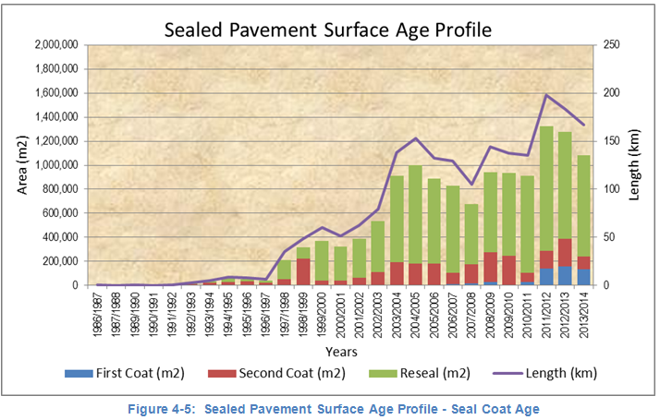
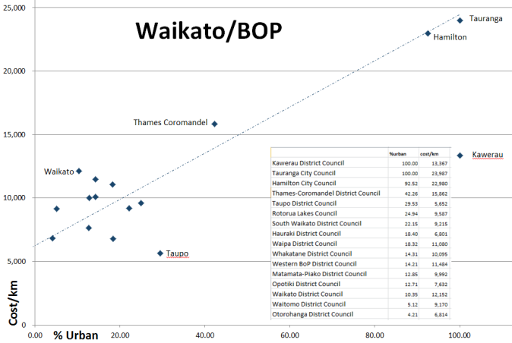
Cost and benefit appraisal for programmes (cont.)
For maintenance, includes such things as:
Verifying supporting data Comparison to others (benchmarking)
Notes:
What are these graphs telling us ??

Slide 14
Cost and benefit appraisal for programmes (cont.) another example for maintenance
Notes:
What are these graphs telling us ??

Slide 15
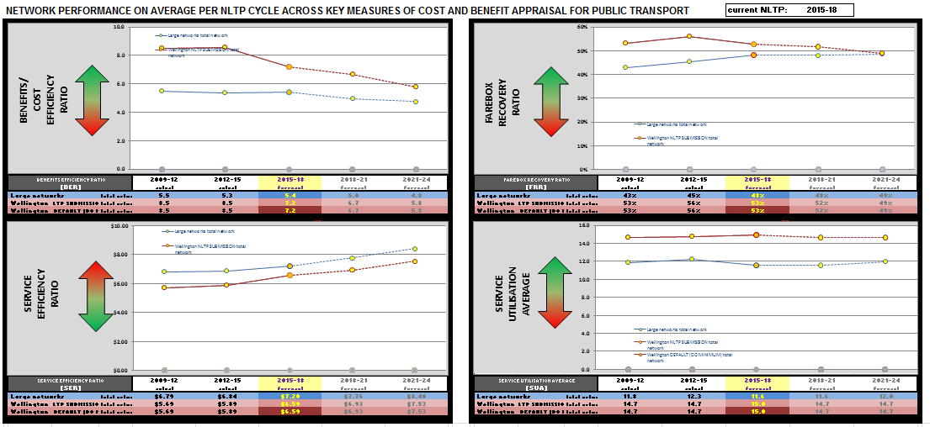
Cost and benefit appraisal for programmes (cont.)
For PT, includes such things as the cost benefit appraisal template:
Notes:
In relation to PT (discuss against graphical displays):
KPI’s monitored and how are these entered
Entered (at the programme level) via TIO as annual data (both achieved and forecasted –as part of the submission).
Variations to these can now be entered into the spreadsheet itself (as a sensitivity test or as an alternate option).
The data entered then generates the KPI’s being monitored.
KPI’s include:
A simplified BCR (direct benefits achieved divided by the costs over a 3 year period);
The farebox ratio (fare revenue divided by the full subsidy over a 3 year period);
The service efficiency ratio (full subsidy over the service kms over a 3 year period); and
The average utilisation (the pax kms divided by the service kms over a 3 year period –used to determine what is the average boardings at any given time)

Slide 16
The Business Case Approach for programmes
An increased level of service:
-For maintenance: reflected via an enhanced programme.
-For PT (an additional CLoS @ >$): requires a separate funding application and potentially a stand alone business case .
Core programmes
- Do not require a separate business case but require the BCA principles to be applied to key planning documentation.
(such as the AMP, the RPTP and RLTPs, etc.) *
Notes:
It is recognised for RPTP’s for example we are in a transitional arrangement where many are not being reviewed and updated until after the NLTP is adopted. Hence, this and a “fit for purpose” approach needs to be recognised as a condition of funding support.

Slide 17
Business Case Approach
Relationship of the BCA to the IAF:
The business case principles and the IAF are clearly linked
Assessment of the business case is the ‘gateway’ (assessment of documentation and the alignment to business case principles)
Business Case Approach
Expected to be covered via planning documentation
(RLTP, AMP and/or RPTP RLTP & AMP, etc)
Assessment of business case
Pass/Rework/Fail
Investment Assessment Framework
Results Alignment
Cost-Benefit Appraisal
Notes:
This is covered in TIO via series of questions and prompts, which will be covered in our session on TIO related to programmes
Not just an arrow down, but a feedback loop as well (from the cost-benefit appraisal for example)

Slide 18
Assessment of Business Case – question level
Each question will be individually assessed and scored as the following:
0 –unacceptable (significant issues requiring conditional support)
1 –basic requirements (recognition of some issues)
2 –acceptable/ balanced (minimal gaps/ risks)
3 –robust/ advanced (completed/ fit for purpose)
Notes:
Each question will be individually assessed as pass rework or fail
Done to seek evidence that strategic thinking has been applied
It enables the Agency to collect information on where the industry needs more guidance and provide feedback to the industry.
Where the assessment is fail or rework, the Transport Agency can take a flexible approach to ensure continuity of funding while issues are addressed

Slide 19
Assessment of Business Case - summary level
After assessing each question, the Transport Agency will assess the investment proposal in its entirety.
Assessment Outcome | All Proposals (Continuous programmes & Improvement Activities)
Pass | The investment partner has provided a proposal that is robust and meets the expectation that the principles of the Business Case Approach have been applied relevant to the phase of the business case
Notes:
NB: Need to detail notes on this in relation to conditions of funding support and what this means (as above)
>OVERALL assessment
After assessing each question, the proposal will be assessed in its entirety
The assessment will check that the investment proposal is robust and meets the expectation that the BCA principles have been applied
The outcome of the assessment of the individual questions will inform and influence the overall pass, rework or fail of the proposal, but it may not determine the funding outcome.

Slide 20
Assessment of Business Case - summary level
After assessing each question, the Transport Agency will assess the investment proposal in its entirety.
Assessment Outcome | Improvement Activities | Continuous Programmes
Rework | The Transport Agency considers that the investment partner is required to complete further work to robustly answer an Assessment of the Business Case question
 | Investment partners will need to complete all rework required to achieve a Pass assessment, or a combination of Pass and Rework assessments by negotiation, before a proposal progresses to the IAF phase | Proposals may proceed so long as an agreed time-bound action plan is established by the investment partner (in this context, either an AO or the Transport Agency) to address the question requirements that will ultimately lead to achieving a Pass assessment

Slide 21
Assessment of Business Case - summary level
The outcome of the assessment of the individual questions will inform and influence the overall pass, rework or fail of the investment proposal, but it may not determine the funding outcome.
Assessment Outcome | Improvement Activities | Continuous Programmes
Fail | The investment partner has not provided the necessary evidence in its business case supporting the investment proposal, and has signalled that no further work is currently planned to complete the required evidence
 | The Transport Agency determines that the business case is not sufficiently robust to support the investment proposal and is assessed as a Fail
 | The proposal does not proceed to the IAF phase until the investment partner agrees to address the business case deficiencies, and the business case is then reassessed as a Rework or Pass | The Transport Agency may decide to progress the proposal for funding, and will define conditions and the potential funding level, if any
Notes:
NB: Need to detail notes on this in relation to conditions of funding support and what this means (as above)
>OVERALL assessment
After assessing each question, the proposal will be assessed in its entirety
The assessment will check that the investment proposal is robust and meets the expectation that the BCA principles have been applied
The outcome of the assessment of the individual questions will inform and influence the overall pass, rework or fail of the proposal, but it may not determine the funding outcome.
?? 1st course mentioned where rework is funded, e.g. RPTP uses WC 003 – do we need to mention this ?

Slide 22
Assessment of Business Case – “TIO look”

Slide 23
Programme profile ratings and application
The outcome of the Assessment of Business Case informs our confidence in the robustness of the funding proposal.
The two assessment factors of Results Alignment and Cost-Benefit Appraisal are brought together to form an assessment profile which determines a proposal’s priority, where the ranking is based on:
Results alignment: meeting the desired results of the investment strategy
Cost benefit: achieving the desired results in the most efficient way

Slide 24
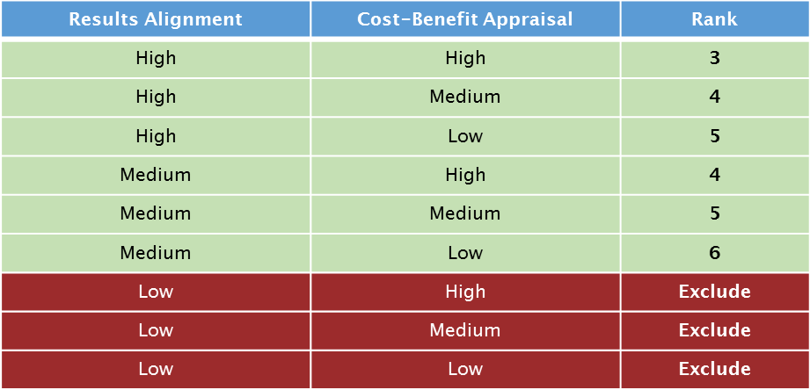
Programme profile ratings and application (cont.)
Funding levels for programmes will be informed by the profile and will take account of the Transport Agency’s intervention hierarchy:
Note - This table is draft and may change pending the final GPS.
Notes:
Note - This table is draft and may change pending the final GPS.
Expect majority of programmes to have Medium Results Alignment. High RA identifies a gap in the service (evidence required) . Low refers to the quality of the AMP.
Note: where improvements have been identified they will fall within the Improvements IAF and may therefore be eligible for rating as very high in Results Alignment and/or Cost-Benefit Appraisal.

Slide 25
Timelines: Continuous Programmes
Programme approval occurs at the time of NLTP adoption
Approval typically* granted across the three year NLTP period
Three stage process to the submissions for Continuous Programmes for the 2018-21 NLTP:
Initial bids – before 31 August 2017
Firm bids – before 20 October 2017
Final bids – before 16 December 2017
Indicative allocations expected mid-April 2018
Notes:
* Note, there may be exceptions where there is only conditional funding support determined by the pass/ rework/ fail assessment (discussed previously).

Slide 26
Continuous Programmes – initial bids
Due by 31 August 2017
Signal any change to strategic environment
Sufficient detail to determine whether what is being proposed is a continuation of an existing programme, or a significant service level change
A ‘first cut’ of funding requirements across each work category of the programme

Slide 27
Continuous Programmes – firm bids
Due by 20 October 2017
A consolidated programme is required showing where the necessary information can be found (e.g. AMP, RPTP etc.)
Review of the Assessment of Business Case with a Transport Agency representative, to ensure all questions are assessed*
Full disclosure of the proposed funding which clearly identifies:
Core programme and, if applicable,
Enhanced programme (maintenance) or
Separate funding application for Improvements - change in service level (PT)
Notes:
* Note: proposals assessed as a fail will require negotiation and agreement on completion within bid submission timeframe to achieve a pass or rework assessment

Slide 28
Continuous Programmes – final bids
Due by 16 December 2017
Completion of the Assessment of Business Case with Transport Agency representative and all questions assessed as a pass or rework
Proposals assessed as a fail will require negotiation and agreement on conditions and potential funding levels;
Transport Agency will provide rationale and implications of any changes from firm bid.

Slide 29
Questions

