Slide 1
TIO changes: 2018-21 NLTP
Road Safety Promotion – detail for takeaway

Slide 2
Road Safety Promotion
Summary
Activities that promote the safe use of the land transport network through education, promotion and advertising
Majority of programmes likely to be made up of activities <$1M
Streamlined approach to assessment will be used

Slide 3
Road Safety Promotion
Key changes in TIO
Assessment of the business case
Redundant fields removed
Support for benefit reporting
Aligning with business case approach – ensuring BCA principles used in development of programme.
Questions reviewed to ensure all that remain are important to our decision making.
Benefits of the programme clearly displayed, making reporting easy. For RSP, the primary benefit is set as ‘Safety’.
Notes:
BCA principles tested – doesn’t mean formal business case required, however, it is expected that the business case approach principles will have been considered throughout the development of the programme
Also – greater level of in-built help text; activity list will be reviewed and updated – there will be an activity list in some shape or form; update to assessment section to reflect new IAF

Slide 4
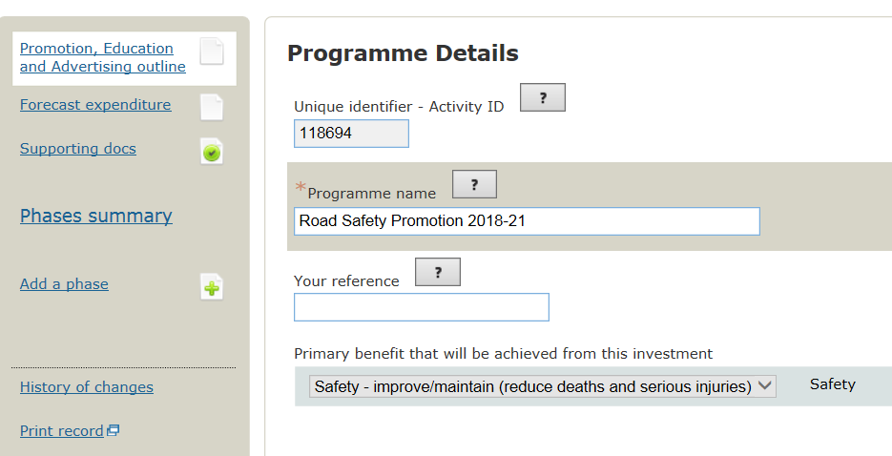
Road Safety Promotion
TIO changes – in depth
Default primary benefit
Notes:
New fields circled – Activity identified clearly displayed; primary benefit set to ‘safety’, cannot be changed

Slide 5
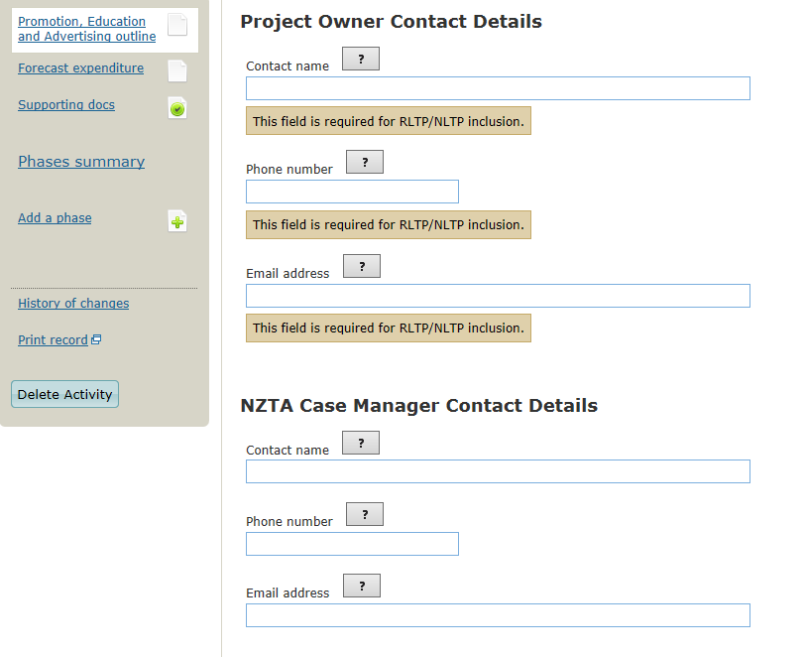
Road Safety Promotion
TIO changes – in depth
Notes:
Contact details, both project owner and NZTA case manager moved to outline page

Slide 6
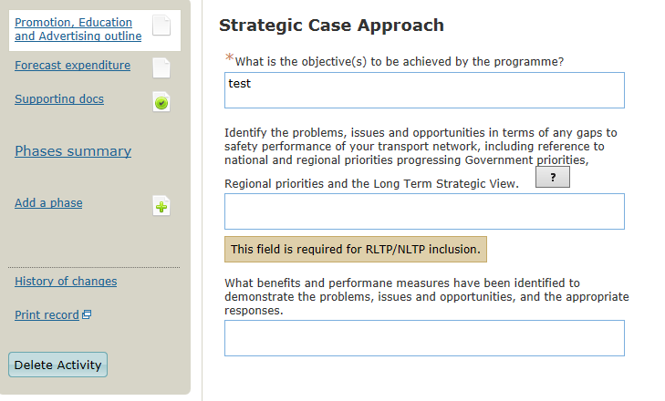
Road Safety Promotion
TIO changes – in depth
[?] denotes help text available – will display on screen once selected
Notes:
Questions aligned to business case approach, reflecting the requirement that programmes are to be developed with business case principles applied whether or not formal business case developed. In most cases the RSAP and/or AMP could be referred to in order to answer these questions.
In-built guidance through questions specific help text – to be developed further for Road Safety Promotion.

Slide 7
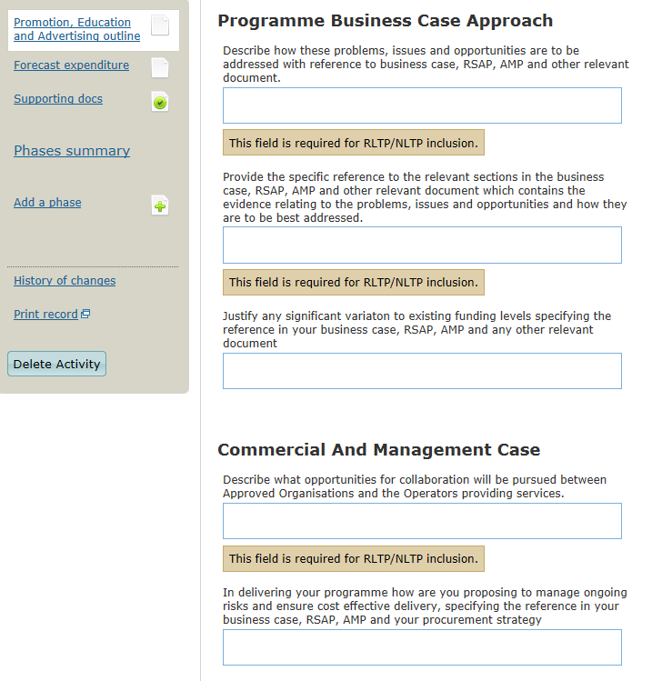
Road Safety Promotion
TIO changes – in depth
Notes:
Questions aligned to business case approach, reflecting the requirement that programmes are to be developed with business case principles applied whether or not formal business case developed. In most cases the RSAP and/or AMP could be referred to in order to answer these questions.
In-built guidance through questions specific help text – to be developed further for Road Safety Promotion.

Slide 8
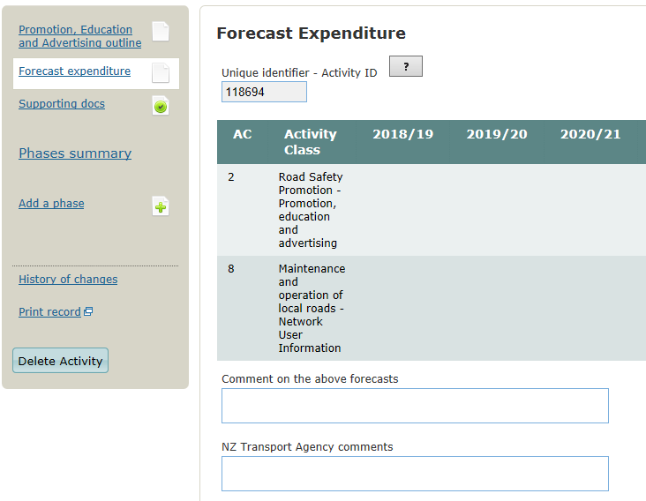
Road Safety Promotion
TIO changes – in depth
Notes:
No change to forecast expenditure, except the activity identified displayed.

Slide 9
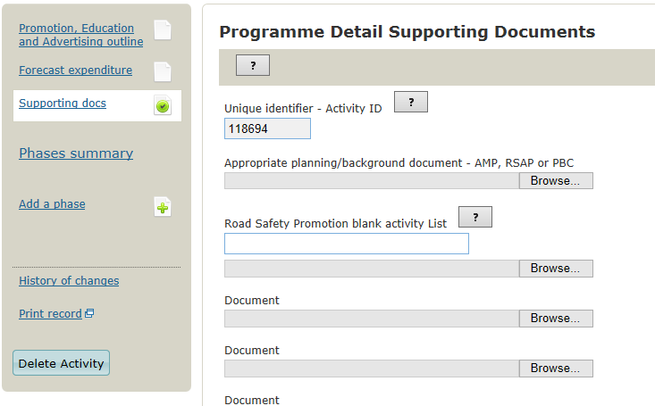
Road Safety Promotion
TIO changes – in depth
Notes:
Supporting docs similar to current template, minor changes include contact details shifted to outline page; section at the bottom for any relevant funding approval and cost/scope adjustment approval supporting documents; activity identifier displayed

Slide 10
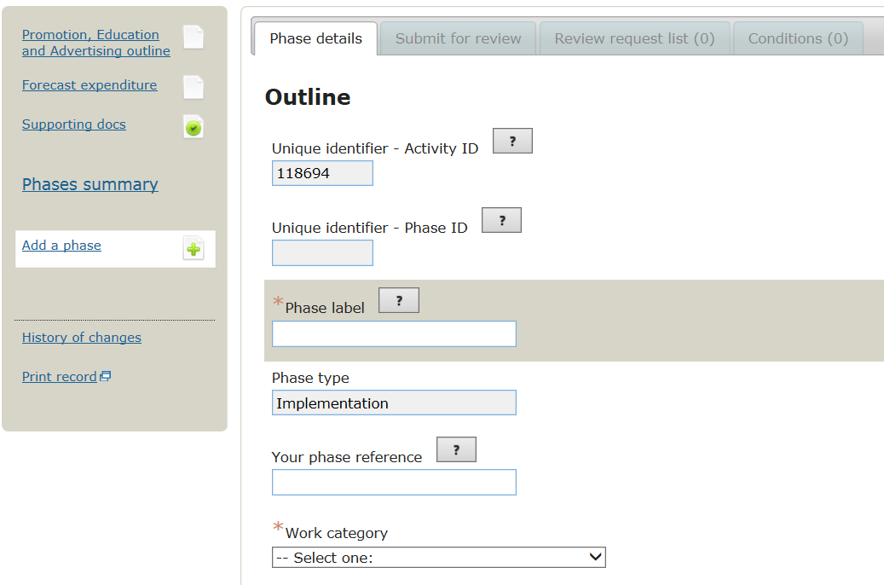
Road Safety Promotion
TIO changes – in depth
Notes:
Top of phase page similar to current template, with addition of clearly displayed activity identifier. The mid section of phase page not displayed contains question about the problem requiring attention and the activity scope as well as the cashflow table – no change from current template.

Slide 11
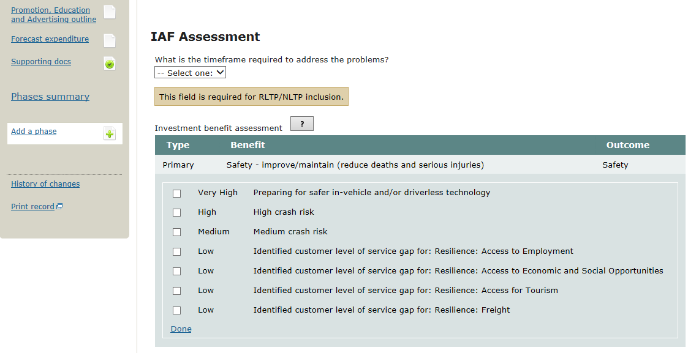
Road Safety Promotion
TIO changes – in depth
Notes:
Change to results alignment on phase page, benefit displayed which triggers the relevant results alignment criteria to be selected from check box list, this provides a suggested rating. Results alignment rating then selected from drop down box with commentary – as in current template (and displayed on next slide).

Slide 12
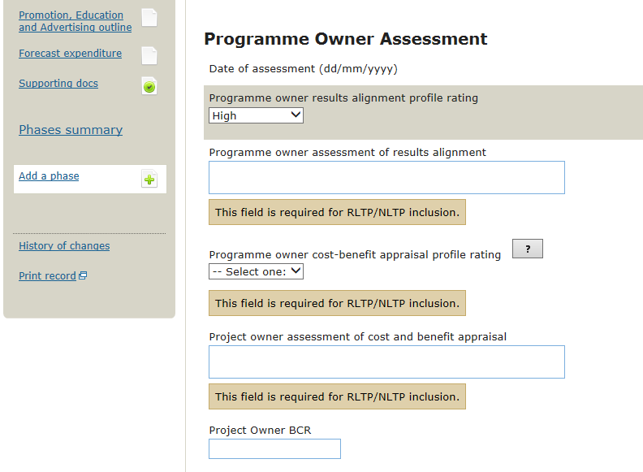
Road Safety Promotion
TIO changes – in depth
Notes:
Change to results alignment on phase page, benefit displayed which triggers the relevant results alignment criteria to be selected from check box list, this provides a suggested rating. Results alignment rating then selected from drop down box with commentary – as in current template.

