Slide 1
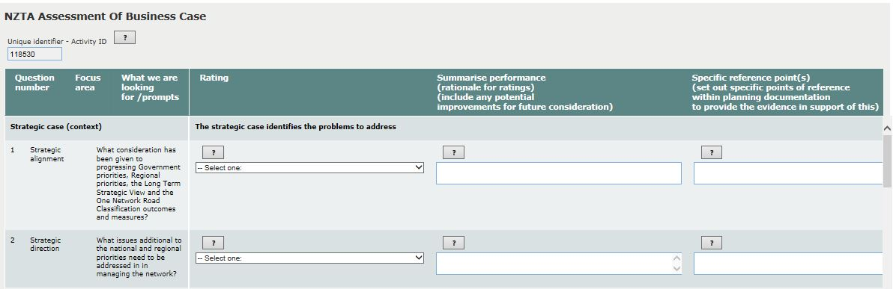
Maintenance BC - NZTA assessment in TIO

Slide 2
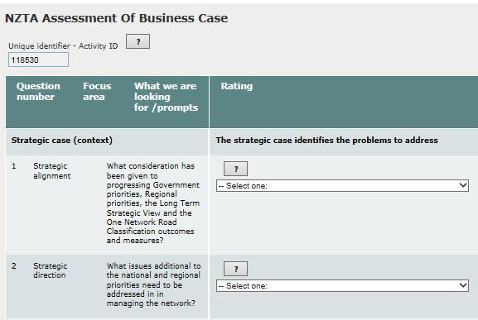
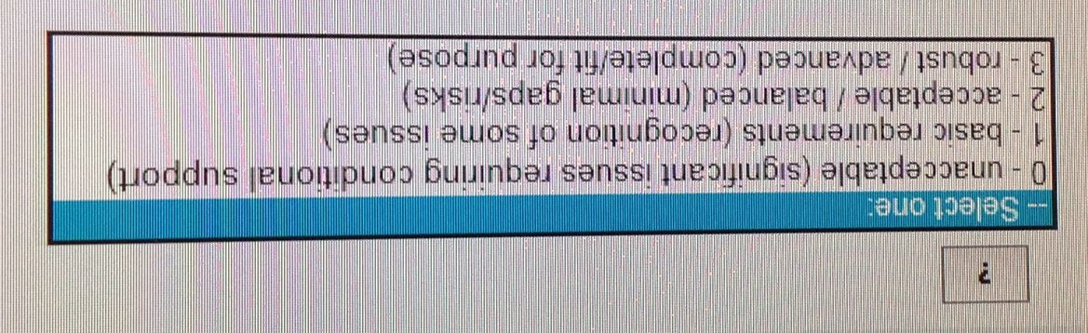
Maintenance BC assessment
11 thematic questions

Slide 3
Q1: Strategic Alignment
What consideration has been given to progressing Government priorities, regional priorities, the One Network Road Classification (ONRC) outcomes and measures? How do the strategic drivers align to the Long Term Strategic View?
Briefly describe the information that demonstrates how the business case:
Supports and aligns to government priorities
Takes account of regional priorities
Is informed by the Long Term Strategic View
Responds to the One Network Road Classification customer levels of service and performance measures framework

Slide 4
Q2: Strategic Direction
What issues additional to the national (GPS) and regional priorities need to be addressed in managing the network?
Briefly describe the information that identifies issues such as:
Long term trends that impact on the network’s customer levels of service
Acceptable levels of service gaps
Risks to the reliability and continuity of the network
Other priorities identified in the business case

Slide 5
Q3: Problem identification- Current state
For the issues identified above, does the business case documentation provide evidence to indicate the scale of the problem, or opportunity, and give some indication of the relative importance and urgency of the issues?
Briefly describe the information that provides:
A clear statement of the current state problem or problems, or opportunities being addressed
What would be the consequences of not addressing the problem(s) or opportunity and the urgency eg 0-3 yrs, 3 – 10 yrs. 10 yrs +

Slide 6
Q4: Objectives (benefits (outcomes)/ performance measures): identified & reasonable
What benefits and performance measures, at a network level related to the maintenance programme, have been identified and are they reasonable? Briefly describe information provided on:
How well the programme responds to the ONRC framework and customer levels of service (current and future state)
The future benefits (outcomes) and how well they will address the problem/s identified
The performance measures for benefits, and whether they will provide adequate evidence that the benefits have been achieved.

Slide 7
Q5: Core programme
For the programme as a whole and for each of the work category bids, is there sufficient evidence to show the programme has been optimised for both the mix and timing of interventions, and is there an appropriate
procurement approach to deliver value for money in the short, medium and long term?
The business case and supporting information must demonstrate and you need to be satisfied that:
The programme has been optimised effectively for scope, quantity, timing and deliverables
What consideration was given to addressing the problems/opportunities through maintenance and/or additional improvement activities (funded through the relevant Improvements Activity Classes) and/or enhanced delivery arrangements
Cost and level of service performance benchmarking compared to national, regional and local peers

Slide 8
Q6: Enhanced programme
Where funding is sought above the Core Programme level, the investment partner will need to demonstrate the rationale and evidence of the value proposition for the enhanced funding request.
The business case and supporting information must demonstrate and you must verify:
  That the additional works and investment proposed are the best means to address the customer levels of service opportunities sought under the Investment Assessment Framework (IAF) High Results alignment rating for maintenance
  The AO has the capability to deliver the proposed enhanced programme in the most cost effective way
  The consequences of not investing in the enhanced programme

Slide 9
Q7: Alignment of programme expenditure
How well are planning documents aligned to the core programme (and any associated funding applications) in TIO?
Review documentation/references provided and provide assurance that there is:
An alignment between the planning documentation and the TIO funding application for the total core programme (including any service improvement(s))
Any gaps are identified

Slide 10
Q8: Smart, fit for purpose procurement of services
What, if any, emerging procurement-related issues and opportunities or outstanding issues have been identified?
Briefly identify:
Whether there is a procurement assessment consistent with the Smart Procurement evaluation guide published by the Road Efficiency Group (REG) procurement group
Any emerging risks or opportunities related to procurement that need to be addressed or accommodated in future
If there are any issues or risks identified in the procurement strategy where further mitigation is required.

Slide 11
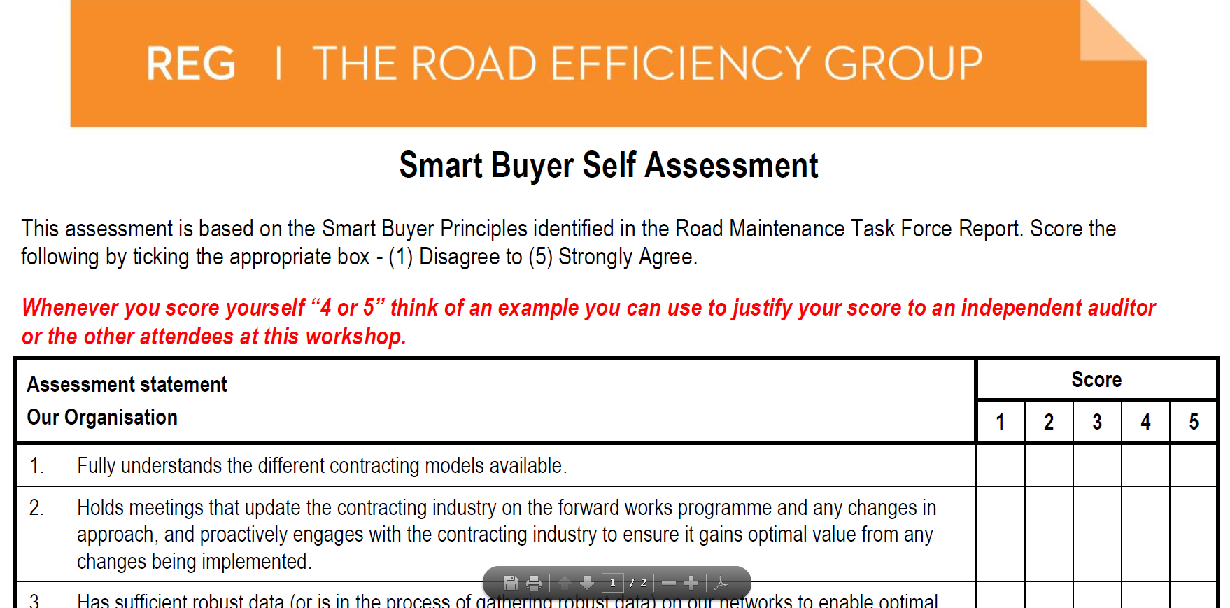
Smart, fit for purpose procurement of services

Slide 12
Q10: Integration / planning
How well is the delivery of the proposed programme and related activities aligned and integrated?
Briefly describe:
How the programme takes account of other agencies programmes / activities that may affect and/or be critical to achieving the desired outcomes
Does the proposal ensure optimal programme delivery efficiency and co-ordination with suppliers and partner organisations?

Slide 13
Q10: Performance management
What is the confidence that the programme can be delivered and risks managed?
Briefly describe:
How findings from previous Transport Agency audits have been, or will addressed, and your confidence in the programme owner to deliver on the planned approach.
Identify, if any, concerns related to delivery of the maintenance programme such as work quality, timeliness of responses, and ability to detect and respond to changes in conditions or circumstances.

Slide 14
Q11: Confidence in delivery/risk management
What is the confidence that the programme can be delivered and risks managed?
Briefly describe:
The proven track record of sound delivery with previous investments in the continuous programme and related activities (particularly in terms of timing and alignment/management of the funding allocation)
The capability and the capacity of the organisation to deliver and manage the future programme and related activities, particularly in terms of adequacy of resourcing and skillsets available
The extent to which risks have been adequately identified for the type/ complexity of the network (and/or related activities) and whether there is a sound risk mitigation strategy in place

